Slide 1
LINEAR ARBORICITY CONJECTURE FOR 3-DEGENERATE GRAPHS
Presented by
AMAN SONKAR
(REG NO. 192671IS004)
M. TECH, CSE(IS)
Under the guidance of
DR. MANU BASAVARAJU
ASSOCIATE PROFESSOR
DEPARTMENT OF CSE
DEPARTMENT OF COMPUTER SCIENCE & ENGINEERING
NATIONAL INSTITUTE OF TECHNOLOGY KARNATAKA, SURATHKAL
MANGALORE - 575025

Slide 2
Introduction
The concept of decomposing a graph into the minimum number of trees or forests is first introduced by Nash-Williams and Tutte in 1961.
The arboricity of a graph is the minimum integer k such that its edge set can be partitioned into k forests.
A linear forest is a forest whose each connected component is a path.
The linear arboricity of a graph is the minimum number of linear forests into which its edge set can be partitioned.

Slide 3
t-degenerate graph
Given a graph G on n vertices and an integer t, an ordering v₁, v₂, . . . , v_{n} of the vertices of G such that for each 1≤ i ≤ n, |{v_{j} : v_{j} ∈ N(v_{i}) and j > i}| ≤ t is called a t-degeneracy ordering of G. A graph G is said to be t-degenerate if it has a t-degeneracy ordering.
Equivalently, a graph G is t-degenerate if every subgraph of G has minimum degree at most t.

Slide 4
K-linear coloring
An edge coloring of a graph G using the colors {1, 2, . . . , k} is a mapping c : E(G) → {1, 2, . . . , k}. Given an edge coloring using colors {1, 2, . . . , k}, the color class i, for some i ∈ {1, 2, . . . , k}, is the set of edges c⁻¹(i) = {e ∈ E(G):c(e) = i}.
A k-linear coloring of a graph G is an edge coloring of G such that each color class is a linear forest.
In other words, it is an edge coloring in which every vertex has at most two edges of the same color incident with it and there is no cycle in the graph whose edges all receive the same color.
The linear arboricity of a graph G is clearly the smallest integer k such that it has a k-linear coloring and is denoted by χ′_{l}(G).

Slide 5
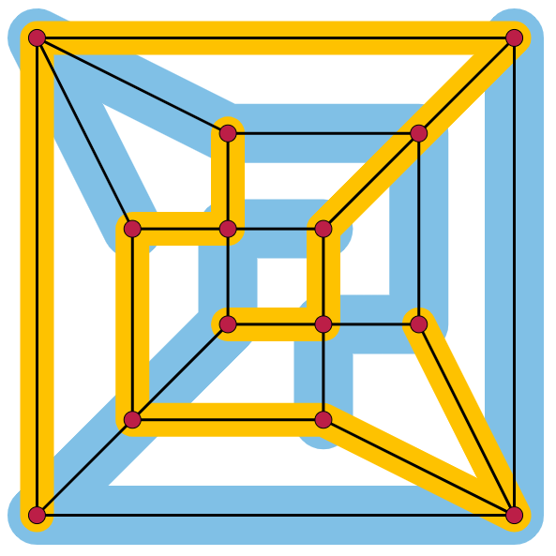
K-linear coloring
Partition of the graph of a rhombic dodecahedron into two linear forests, showing that its linear arboricity is two.

Slide 6

Linear Arboricity Conjecture
The linear arboricity conjecture, first stated by Akiyama, Exoo & Harary (1981) asserts that for every simple graph G with maximum degree Δ = Δ(G),
The linear arboricity of every Δ(G)-regular graph is ⌈(∆(G)+1) /2⌉.
The best known general upper bound for la(G) is la(G) ≤ ⌈3∆/5⌉ for even ∆ and la(G) ≤ ⌈(3∆ + 2)/5⌉ for odd ∆.

Slide 7
Theorem
Let G be a 3-degenerate graph having ∆(G) ≤ 2k − 1, where k is a positive integer. Then χ′_{l}( G) ≤ k.
This generalizes the result of Akiyama, Exoo and Harary who showed that every cubic graph has a 2-linear coloring.
We assume that all 3-degenerate graphs having maximum degree at most 2k − 1 and less than |E(G)| edges can be linearly colored using k colors. We shall show that G can be linearly colored using k colors.

Slide 8
Preliminaries
Let G be a t-degenerate graph. A pivot in G is a vertex that has at most t neighbors of degree more than t. A pivot edge in G is an edge between a pivot and a vertex with degree at most t.
Identification of vertices: Given a graph G and vertices u, v ∈ V (G) such that uv ∉ E(G) and N(u) ∩ N(v) = ∅, we let G/(u, v) denote the graph obtained by “identifying” the vertex v with u. That is, V (G/(u, v)) = V (G) \ {v} and E(G/(u, v)) = E(G − v) ∪ {ux: x ∈ N(v)}.

Slide 9
Preliminaries
Let c be a k-linear coloring of a graph G. For a vertex x ∈ V (G),
Colors(x) denote the set of colors in {1, 2, . . . , k} that appear on the edges incident with x,
Missing(x) to be the colors in {1, 2, . . . , k} that do not appear on any edge incident with x,
Twice(x) to be the set of colors that appear on two edges incident with x, and Once(x) to be the set of colors that appear on exactly one edge incident with x.
Note that for any vertex x ∈ V (G), |Missing(x)| + |Once(x)| + |Twice(x)| = k and also that the degree of x in G is |Once(x)| + 2|Twice(x)|.

Slide 10
Proof of Theorem
Let uv be a pivot edge of G such that d_{G}(u) ≤ 3 and v is a pivot.
Lemma 1. If d_{G}(v) < 2k − 1, then G has a k-linear coloring.
Proof. Let H = G − uv. By the induction hypothesis, there is a k-linear coloring c of H.
Claim. If either
|Once(v)| ≥ 3, or
|Missing(v)| ≥ 1 and |Missing(v) ∪ Once(v)| ≥ 2,
then G has a k-linear coloring.

Slide 11
Proof of Theorem
Observe that d_{H}(v) = 2|Twice(v)| + |Once(v)|.
From the claim, if |Missing(v)| + |Once(v)| ≥ 3, then we are done. Therefore, we shall assume that |Missing(v)| + |Once(v)| ≤ 2. As |Twice(v)| + |Once(v)| + |Missing(v)| = k, this means that |Twice(v)| ≥ k − 2.
Since d(v) ≤ 2k − 2, we have dH(v) ≤ 2k − 3, implying that |Twice(v)| ≤ k − 2. Thus, we have |Twice(v)| = k − 2.
Since 2k − 3 ≥ d_{H}(v) = 2|Twice(v)| + |Once(v)|, we get |Once(v)| ≤ 1. Since |Twice(v)| + |Once(v)| + |Missing(v)| = k, we have |Missing(v)| ≥ 1 and |Missing(v)| + |Once(v)| = 2.
We are now done by the above claim.

Slide 12
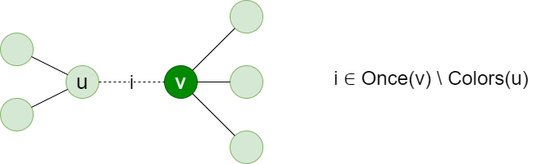
Proof of Theorem
Case 1 : |Once(v)| ≥ 3 :

Slide 13
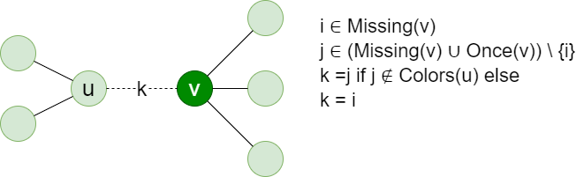
Proof of Theorem
Case 2 : |Missing(v)| ≥ 1 and |Missing(v) ∪ Once(v)| ≥ 2 :
This proves the claim.

Slide 14
Proof of Theorem
Lemma 2. If uw ∈ E(G), then G has a k-linear coloring.
Proof. Let H = G − {u, w}. Let x be a neighbor of u other than v, w. Similarly, let y be a neighbor of w other than u, v, if such a neighbor exists.
By the inductive hypothesis, there exists a k-linear coloring c of H. Since d_{H}(x) ≤ 2k − 2, there exists a color i ∈ Missing(x) ∪ Once(x). Color ux with i. Since d_{H}(v) = 2k − 3, we know that either:
|Once(v)| = 3, or
|Missing(v)| = 1 and |Once(v)| = 1.

Slide 15
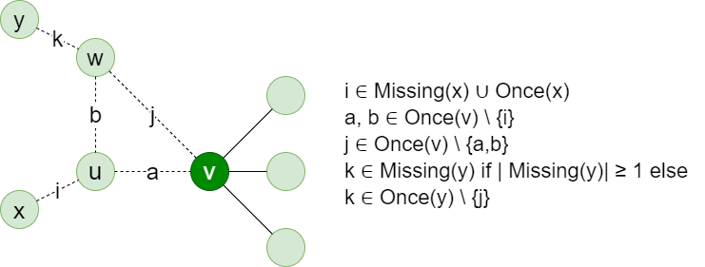
Proof of Theorem
Case (a) : |Once(v)| = 3

Slide 16
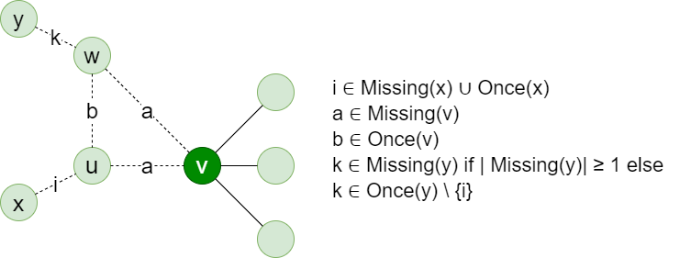
Proof of Theorem
Case (b) : |Missing(v)| = 1 and |Once(v)| = 1
This gives a k-linear coloring of G.

Slide 17
Proof of Theorem
Lemma 3. If u and w have a common neighbor other than v, then G has a k-linear coloring.
Proof. Let z be a common neighbor of u and w other than v. Note that by Lemma 2, we can assume that uw ∉ E(G). As in the proof of Lemma 2, we assume that u has a neighbor x other than v, z and w has a neighbor y other than v, z.
Define H = G − {u, w}. Clearly, d_{H}(v) = 2k − 3 and d_{H}(z) ≤ 2k − 3. Thus we have either |Once(v)| ≥ 3 or both Missing(v) ≠ ∅ and |Missing(v) ∪ Once(v)| ≥ 2. Since we also have that either |Once(z)| ≥ 3 or both Missing(z) ≠ ∅ and |Missing(z) ∪ Once(z)| ≥ 2, we treat v and z symmetrically, so there are only three cases to consider.

Slide 18
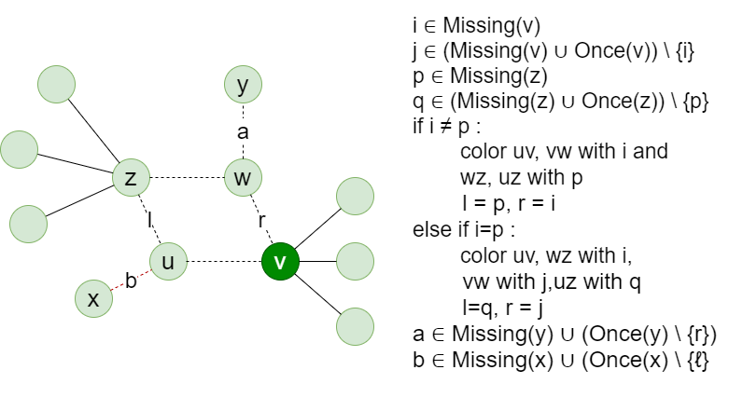
Proof of Theorem
Case 1 : Missing(v) ≠ ∅, |Missing(v) ∪ Once(v)| ≥ 2
Case (a) : Missing(z) ≠ ∅, and |Missing(z) ∪ Once(z)| ≥ 2 :

Slide 19
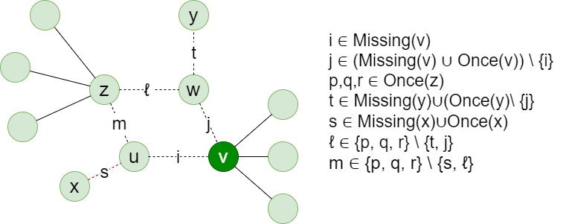
Proof of Theorem
Case 1 : Missing(v) ≠ ∅, |Missing(v) ∪ Once(v)| ≥ 2
Case (b) : |Once(z)| ≥ 3 :

Slide 20
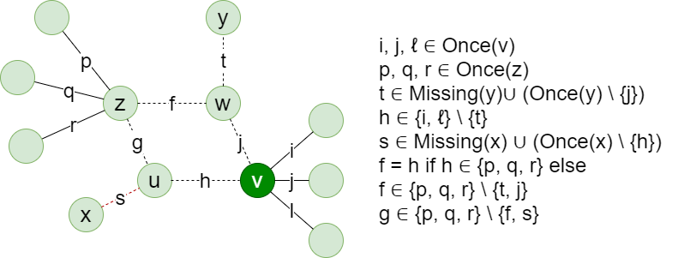
Proof of Theorem
Case 2 : |Once(v)|, |Once(z)| ≥ 3 :

Slide 21
Proof of Theorem
Now By Lemma 3, we can assume that u and w have no common neighbors other than v. assume that w has two neighbors x and y other than v (if not, new vertices of degree one adjacent to w can be added so as to ensure that x and y always exist).
By Lemma 2, we can assume that uw ∉ E(G), which further implies that x and y are distinct from u.

Slide 22

Proof of Theorem
Let H = G − {uv, vw, wx}. Let H′ be the graph obtained by identifying the vertex w with u in H; i.e. H′ = H/(u, w). Notice that dH′ (u) ≤ 3 and that the graph H′ − u is nothing but G − {u, w}, which is a 3-degenerate graph as d_{G}(u), d_{G}(w) ≤ 3. Thus, H′ is a 3-degenerate graph having |E(H)| < |E(G)|. Then by the inductive hypothesis, there exists a k-linear coloring c′ of H′.
Let c be the coloring of H obtained by “splitting” the vertex u in H′ to get back H. Formally, we define for all e ∈ E(H)

Slide 23
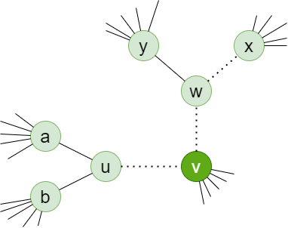
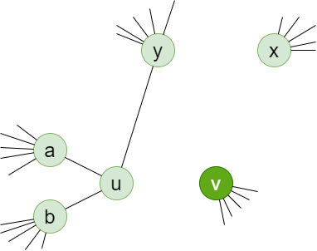
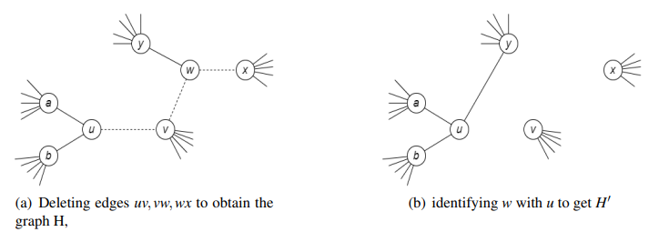
Proof of Theorem
Construction of the graph H’

Slide 24
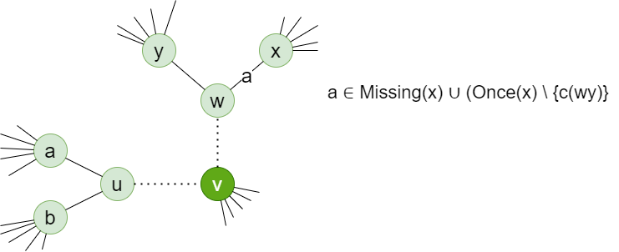
Proof of Theorem
Note that since dH (x) ≤ 2k − 2, either |Missing(x)| ≥ 1 or |Once(x)| ≥ 2. We first extend c to a coloring of G − {uv, vw} by coloring the edge wx by a color in Missing(x) ∪ (Once(x) \ {c(wy)}.

Slide 25
Proof of Theorem
Since d_{H}(v) = 2k − 3, we have that either both |Missing(v)| = 1 and |Once(v)| = 1, or |Once(v)| = 3.
Case 1 : |Missing(v)| = 1 and |Once(v)| = 1 :
Let Missing(v) = {i} and Once(v) = {j}. First, suppose that i belongs to either Twice(u) or Twice(w). We shall assume by the symmetry between u and w that i ∈ Twice(u). Color uv with j and vw with i (note that i ∉ Twice(w) as if that were the case, u would have three edges of color i incident with it in c′) to obtain a k-linear coloring of G. So let us assume that i ∉ Twice(u) ∪ Twice(w). If j ∈ Twice(u) ∪ Twice(w), then we can color uv and vw with i to obtain a k-linear coloring of G. Thus, we can now assume that i, j ∉ Twice(u) ∪ Twice(v). If there is a path of color j having endvertices u and v, then color uv with i and vw with j (we know by Observation 2 that there is no path of color j having endvertices v and w). Otherwise, color uv with j and vw with i.
We now have a k-linear coloring of G.

Slide 26
Proof of Theorem
Case 2 : |Once(v)| = 3 :
Let Once(v) = {i, j, ℓ}. Let L ∈ Once(u) ∩ Once(v)). The fact that d_{H}(u) ≤ 2 implies that 0 ≤ |L| ≤ 2.
If |L| = 2, then color vw with a color in L \ Twice(w) and uv with a color in {i, j, ℓ} \ L. Otherwise color vw with a color r ∈ {i, j, ℓ} \ Colors(w) and uv with a color in {i, j, ℓ} \ ({r} ∪ Twice(u) ∪ L).
We now have a k-linear coloring of G.

Slide 27
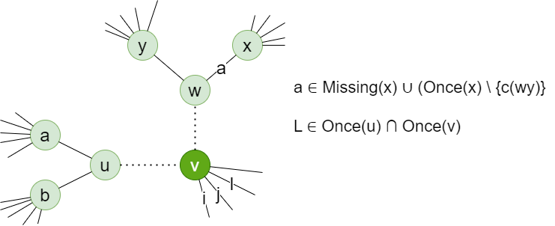
Proof of Theorem
Case 2 : |Once(v)| = 3 :
This completes the proof of Theorem 1.

Slide 28
Implementation and results
We convert this proof to a linear time algorithm that computes a ⌈(∆(G) + 1)/2⌉-linear coloring for any input 3-degenerate graph G.
Algorithm for k-linear coloring of 3-degenerate graph
Input : The algorithm takes as input a graph G and a set S of vertex-edge incidences of G.
Output : The algorithm computes a pseudo-k-linear coloring of (G, S) by populating the data structures that encode the coloring. If we want the algorithm to produce a k-linear coloring of G, we simply give the set S = φ as input to the algorithm.

Slide 29
Implementation and results
Initialization Phase
First of all, Perform the Initialization that consists of doing some preprocessing :
Initialize the data structures required to encode the graph and the pseudo-k-linear coloring,
Construct the Graph and compute the degrees of each vertex,
Encoding the coloring,
Construct the list Pivots of pivots that have at least one pivot edge incident with them.
Note that after the initialization, no edges are colored, so for every vertex u, we will have Onc(u) = Φ and Miss(u) will contain all the colors in {1, 2, . . . , min {d(u) + 2, k}}. Also, there will be no segment objects. Then we invoke a recursive procedure Color(G, S) which constructs a pseudo-k-linear coloring of (G, S) by populating the data structures that encode the coloring.

Slide 30
Implementation and results
B. The Procedure COLOR(G,S)
The procedure returns a pseudo-k-linear coloring of (G, S) by storing the color of each edge in its node in the list Edges, by filling data in the lists Miss and Onc of each vertex, and also by constructing a collection of segment objects representing the maximal monochromatic segments of (G, S) under the coloring.

Slide 31
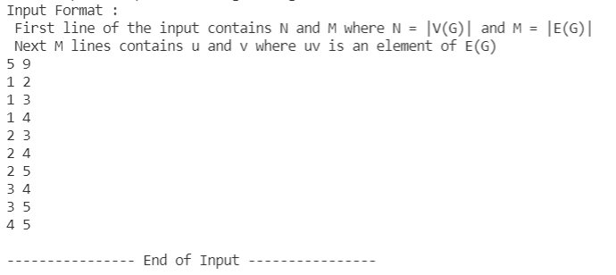
Implementation and Results

Slide 32
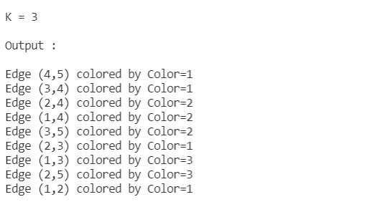
Implementation and Results

Slide 33
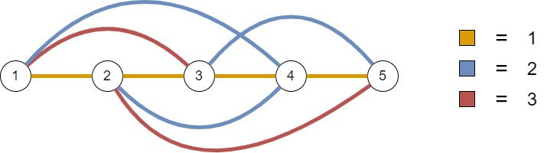
Implementation and Results

Slide 34
Implementation and result
In this algorithm, we computes a k-linear coloring of a 3-degenerate graph G having ∆(G) ≤ 2k −1 that also shows that χ’_{l}(G) ≤ ⌈(∆(G) +1)/2⌉. This linear-time algorithm provides the efficient way to partition the edge set of any 3-degenerate graph G on n vertices into at most d(∆(G) +1)/2e. Also, the output produced by an algorithm for a random test input graph, shown in figure, justify that algorithm works correctly.

Slide 35
Conclusion and future work
We have observed that the results computed for the proposed approaches are correct for all input experimental programs. This experimentally validated the correctness of our linear-time algorithm and also shows that for every 3-degenerate graph G, χ’_{l}(G) ≤ ⌈d(∆(G) +1)/2⌉.
We have identified several opportunities for future research. Since the proposed algorithm used to partitions the edge set of any 3-degenerate graph, as our future work, we plan to modify this method to apply on 4-degenerate graph.

Slide 36
Thank You

